Slide 1
THE SEB NETWORK
#LekkerBezig #SEB #FRIESLANDCOLLEGE #ONDERNEMERSCOLLEGE

Slide 2
13:00-13:15 | CONNECT
13:15 - 14:30 | FINISH THE S.B.A. WEEK 1 and 2 CHECKLIST
14:30 – 16:50 | THE SEB NETWORK (TAKE A BREAK WHEN YOU NEED IT)
16:50 – 17:00 | REFLECTION / INFO ABOUT NEXT WEEK

Slide 3
GOALS
EXPLORATION OF SUSTAINABILITY
FINISHING THE SBA
PREPARING THE PRESENTATION FOR NEXT WEEK
PRACTICING: CURIOSITY / SEEING OPPORTUNITIES/ TAKING INITIATIVE
PRACTICING SEB SKILLS!

Slide 4
YOU NOW WORK FOR THE SEB-NEWS NETWORK
THE SNN IS A NEWS NETWORK BASED AT FRIESLAND COLLEGE.
IT IS RUN BY STUDENTS
IT IS GOING TO MAKE A FRIESLAND COLLEGE REPORT ABOUT SUSTAINABILITY FOR THE NATIONAL DAY OF SUSTAINABILITY (10 OCTOBER)
IT’S GOING TO LOOK A BIT LIKE….

Slide 5
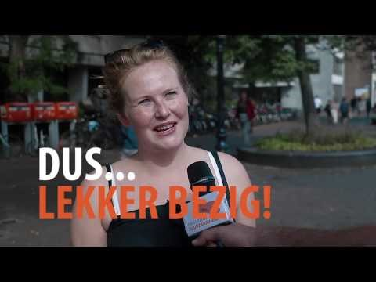
THIS…

Slide 6
THERE ARE THREE ROLES
THE JOURNALIST
THE MOVIE-MAKER
THE WRITER/COACH

Slide 7
THE JOURNALIST
YOU READ THE INTRO TEXT (just the voice)
YOU ASK IF YOU CAN INTERVIEW THE PEOPLE (IN DUTCH). ASK NICELY
YOU ASK THE QUESTION: “WAT DOE JIJ AAN DUURZAAMHEID?”
IF THEY DON’T KNOW WHAT “DUURZAAMHEID” IS, YOU GIVE EXAMPLES (DON’T FILM THAT)
YOU ASK A FEW OF THEM (IF THEY ARE NICE): “IS DAT ALLES?”
YOU TELL EVERYONE WHO IS DOING SOMETHING SUSTAINABLE: “LEKKER BEZIG”
YOU THANK ALL OF THEM FOR THEIR TIME
IF THEY ASK, THE VIDEO WILL BE ONLINE ON SEBLINGS.NET HOMEPAGE NEXT WEEK TUESDAY. IT WILL BE AVAILABLE TO EVERYONE (THERE’S A PASSWORD ON THE WEBSITE NOW)

Slide 8
THE MOVIE-MAKER
YOU FILM
YOU MAKE SURE THE SOUND IS OK
YOU MAKE SURE YOU HAVE GOOD LIGHT
YOU MAKE SURE THE QUALITY IS GOOD
YOU MAKE SURE THE TEACHER GETS THE VIDEOS IN FULL QUALITY
YOU MAKE SURE THE TEACHER KNOWS WHAT SONG TO USE AS A BACKGROUND (INSTRUMENTAL)
IF YOU CAN, YOU EDIT THE VIDEO YOURSELF

Slide 9
THE WRITER/ COACH
YOU WRITE THE INTRO AND OUTRO TEXT IN ENGLISH
YOU WRITE A CONCLUSION: ARE THE PEOPLE “LEKKER BEZIG?” WHY YES/ NOT?
YOU MAKE SURE THAT YOU EXPLAIN THAT THIS IS ABOUT FRIESLAND COLLEGE PEOPLE
YOU COMMUNICATE WITH THE JOURNALIST AND FILM-MAKER
YOU SUPPORT THE CAMERAMAN AND JOURNALIST WITH WHATEVER THEY NEED
YOU MAKE SURE EVERYTHING IS DONE TODAY
YOU THINK OF AT LEAST ONE ORIGINAL IDEA AND YOU PUT IT IN THE VIDEO
YOU MAKE SURE THERE ARE AT LEAST TEN INTERVIEWS YOU CAN USE

Slide 10
IF YOUR GROUP CAN’T EDIT THE VIDEO
The teacher will edit the video for you!

Slide 11
MINIMUM
10 USABLE INTERVIEWS PER GROUP
THE TEACHER WILL DO IT FOR YOU.
CAN’t EDIT THE VIDEO?

Slide 12
BE NICE
Be nice to people you try to interview.

Slide 13
FINISHED?
PREPARE YOUR PRESENTATION FOR NEXT WEEK!
MAKE SURE YOU GET IN TOUCH WITH YOUR PARTNER ABOUT HOW TO DO IT.

Slide 14
REFLECTION

Slide 15
GOALS
EXPLORATION OF SUSTAINABILITY
FINISHING THE SBA
PREPARING THE PRESENTATION FOR NEXT WEEK
PRACTICING: CURIOSITY / SEEING OPPORTUNITIES/ TAKING INITIATIVE
PRACTICING SEB SKILLS!

Slide 16
REFLECTION
CURIOSITY?
OPPORTUNITIES?
INITIATIVE?

Slide 17
NEXT WEEK

